Slide 1

Visión por Computador
Domingo Mery
Departamento de Ciencia de la Computación
Escuela de Ingeniería
Universidad Católica de Chile
CNN
[ Capítulo 3 ]

Slide 2
Motivation

Slide 3
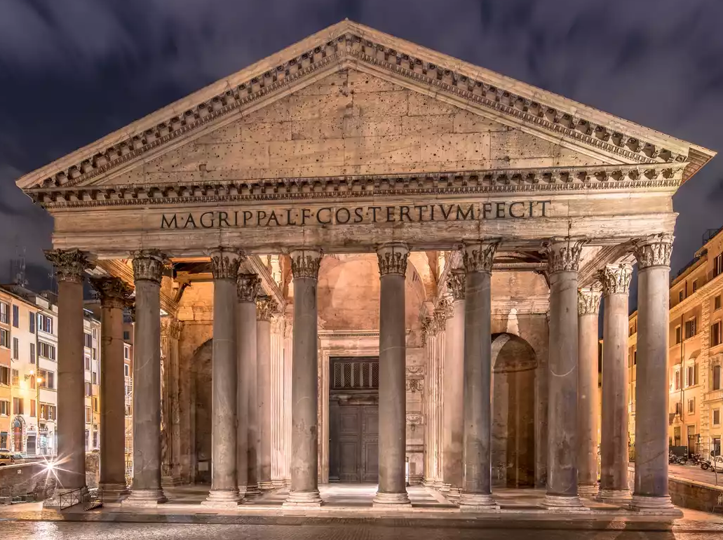

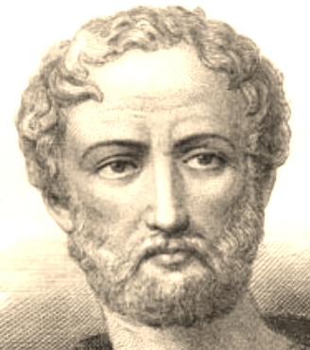
THE HISTORY OF COMPUTER VISION
Notes:
Much of the work in computer recognition of faces has focused on detecting individual features such as the eyes, nose, mouth, and head outline, and defin- ing a face model by the position, size, and relation- ships among these features. Beginning with Bled- soe’s [2] and Kanade’s [3] early systems, a number of automated or semi-automated face recognition strategies have modeled and classified faces based on normalized distances and ratios among feature points. Recently this general approach has been continued and improved by the recent work of Yuille et al. [4].

Slide 4
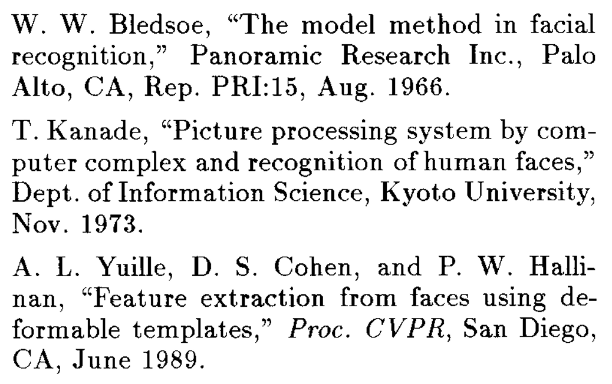
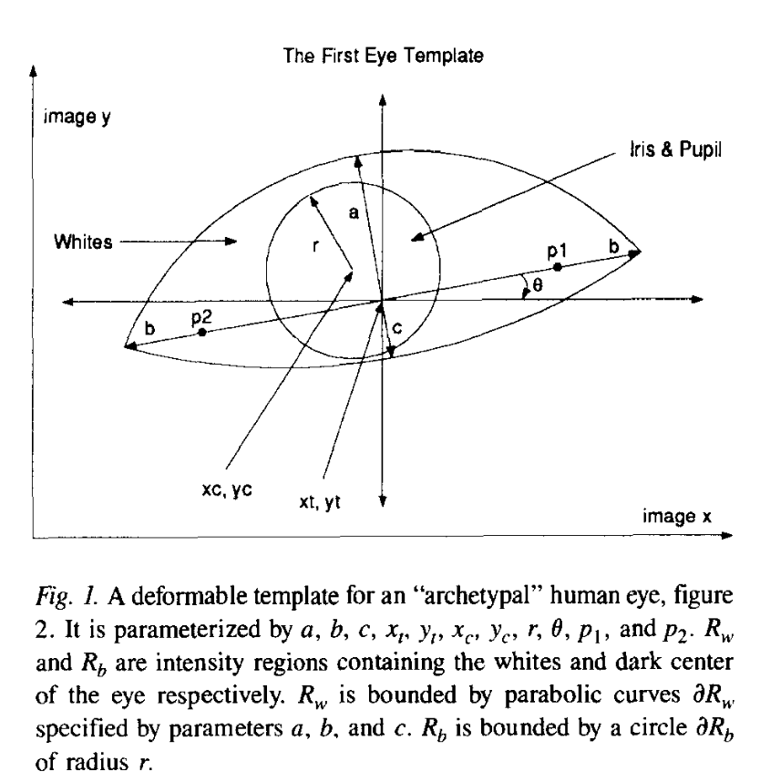
Face recognition based on normalized distances and ratios among feature points
THE HISTORY OF COMPUTER VISION
Notes:
Much of the work in computer recognition of faces has focused on detecting individual features such as the eyes, nose, mouth, and head outline, and defin- ing a face model by the position, size, and relation- ships among these features. Beginning with Bled- soe’s [2] and Kanade’s [3] early systems, a number of automated or semi-automated face recognition strategies have modeled and classified faces based on normalized distances and ratios among feature points. Recently this general approach has been continued and improved by the recent work of Yuille et al. [4].

Slide 5
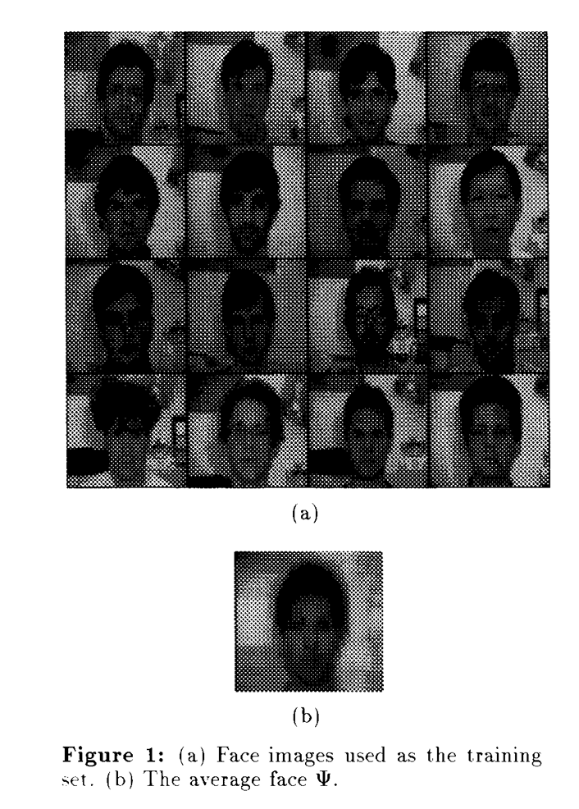
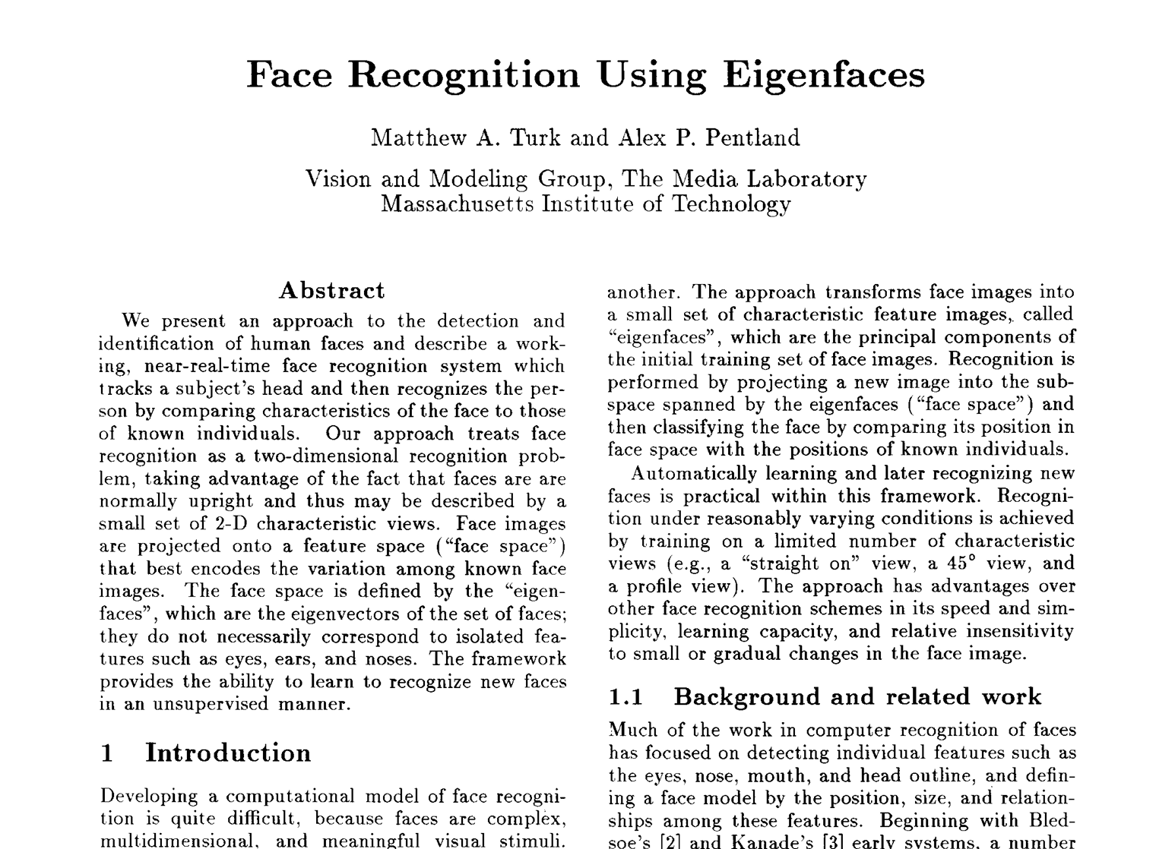
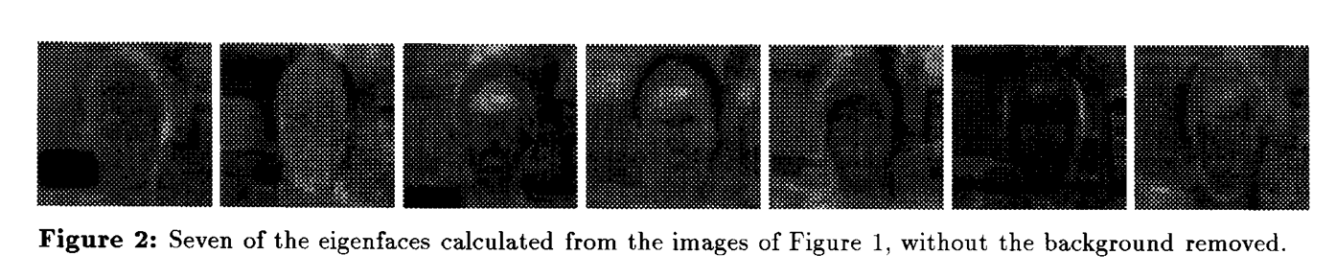
CVPR 1991 Best Paper Award

Slide 6
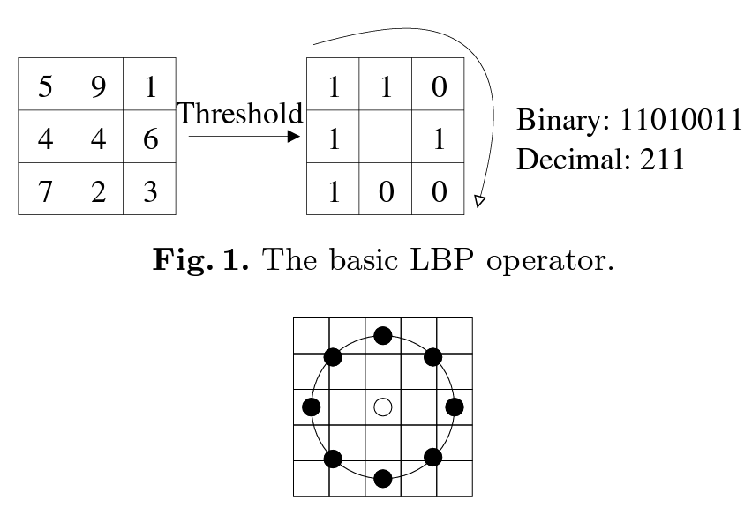
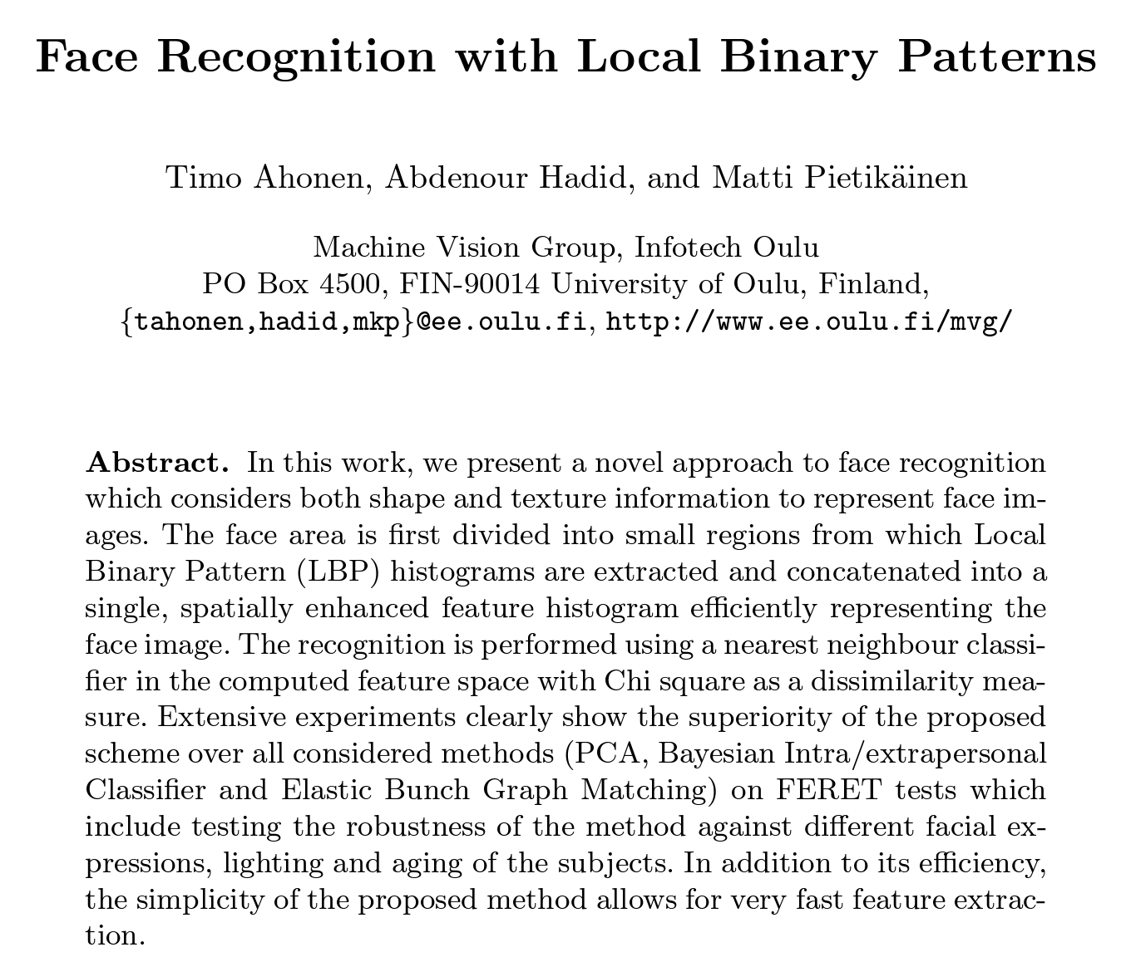
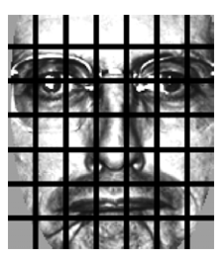
ECCV 2004

Slide 7
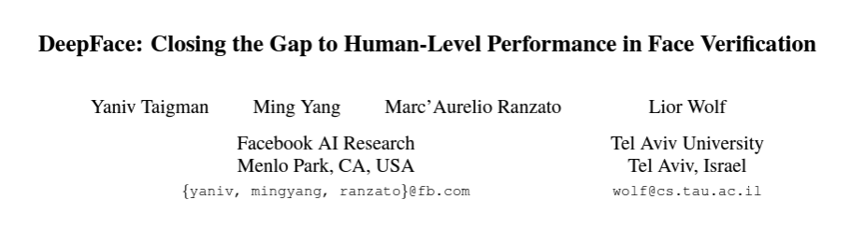
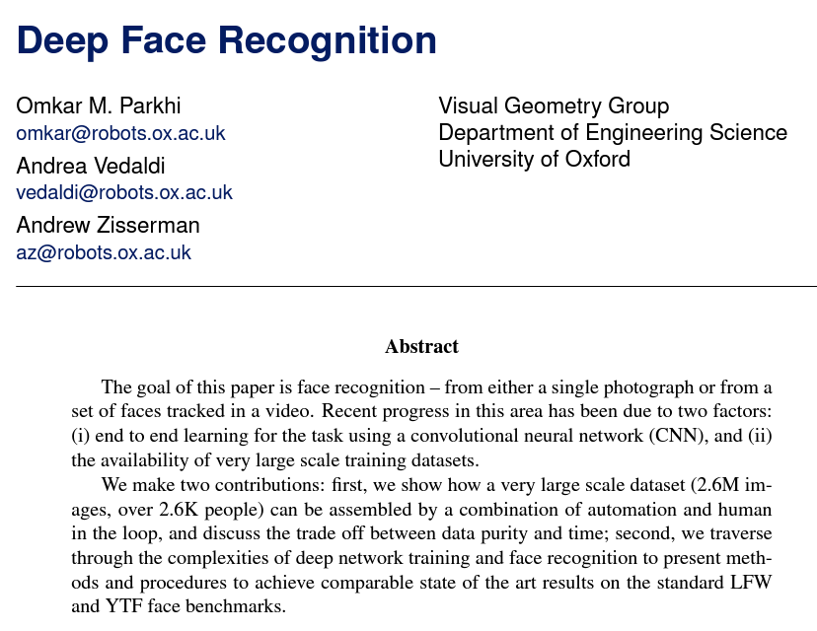
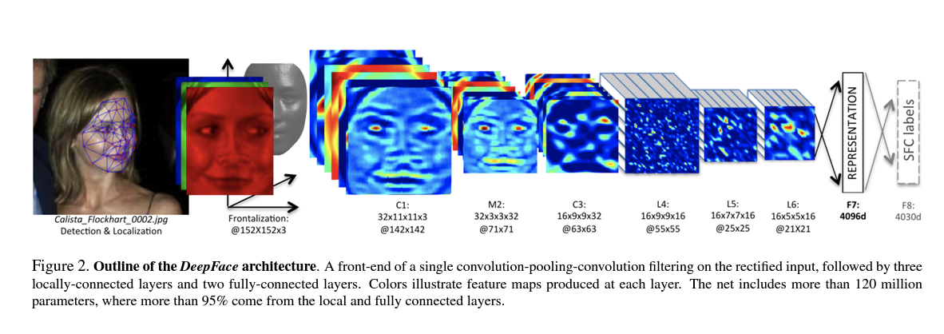
CVPR 2014
BMVC 2015

Slide 8
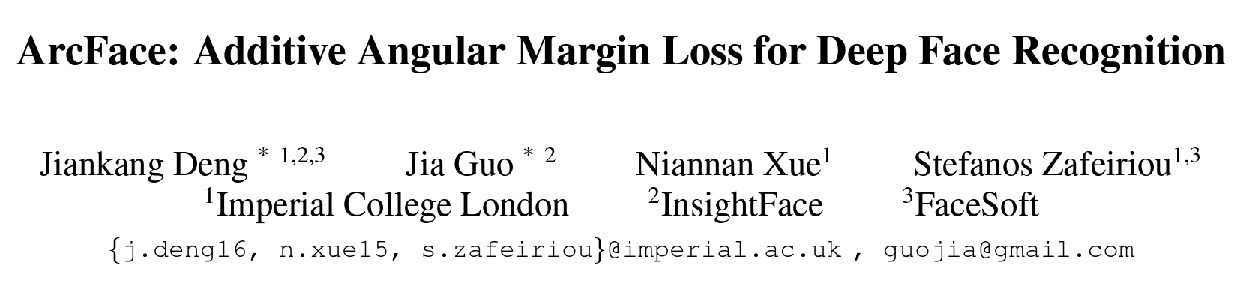
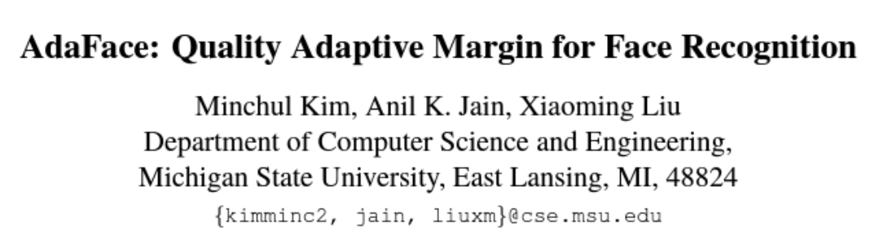
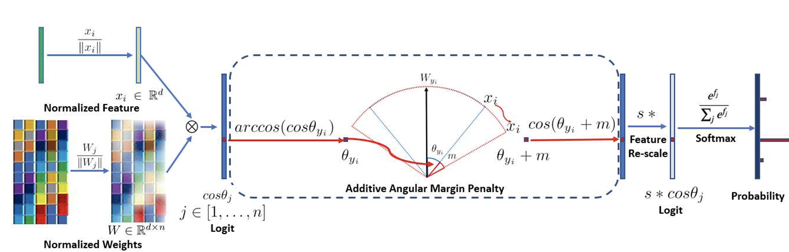
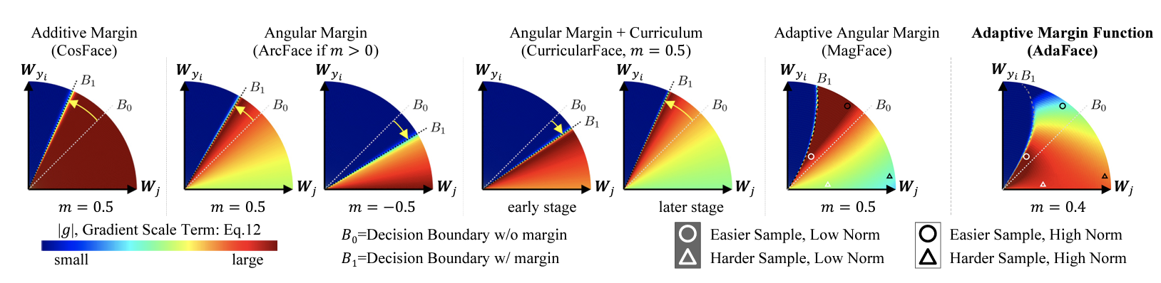
CVPR 2019
CVPR 2022

Slide 9
Images of different
known classes
Representation
Class 1
Feature Feature Design of
Extraction Selection Classifier
Class 2
Class n
Stage 1: TRAINING
Stage 2: TESTING
Extraction of
selected
features
InputA: Test Image
Class
Classification
Output:

Slide 10
MOTIVATION
Handcrafted vs. Learned features
LBP, Haralick, Fourier, Gabor, etc.
or
Learned representation from training data

Slide 11
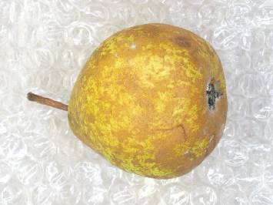
Pattern Recognition
The use of computer algorithms that take data as input and return a class, a measurement, an interpretation or a decision.
Quality: “Premium”

Slide 12
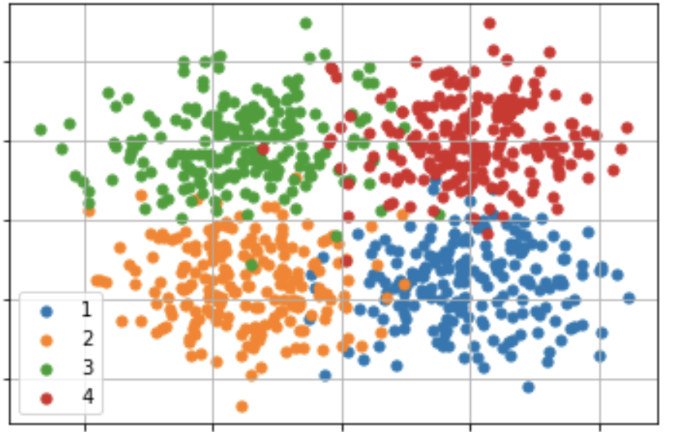
Pattern Recognition
Quality of the Fruit
Weight (x₂)
Sugar (x₁)

Slide 13
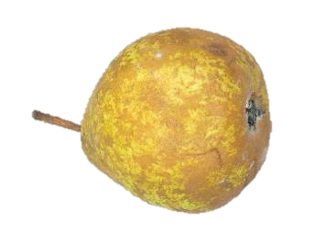
Pattern Recognition
Quality of the Fruit
Weight (x₂)
Sugar (x₁)

Slide 14
Pattern Recognition
Quality of the Fruit
Weight (x₂)
Class “4”
Sugar (x₁)

Slide 15
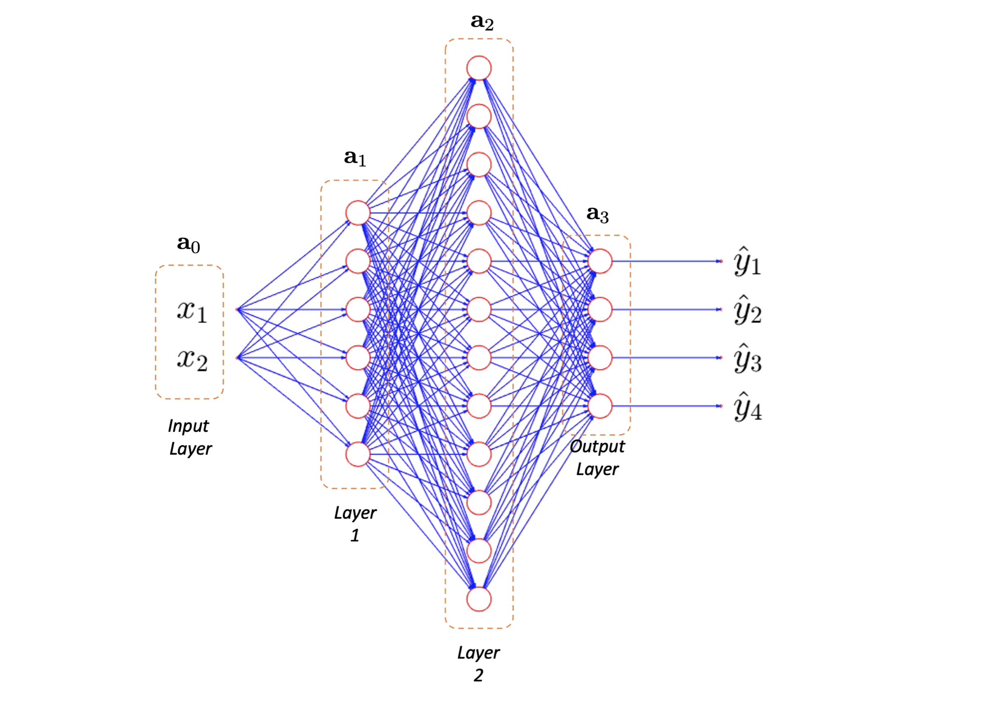


errors
Neural Network
TRAINING
x₁ x₂
7.8402 1.5190
9.7145 0.0424
7.1526 -4.1852
13.0419 -3.3597
10.2582 4.4638
11.6146 0.5340
7.4023 -1.8662
5.8033 -3.7628
8.9302 0.9052
8.1835 3.4355
10.6855 2.7405
9.1418 -0.4821
9.9633 6.2377
10.4738 4.9295
9.3004 3.5021
9.7183 1.9630
15.1194 2.0790
4.2210 -3.2440
1.5316 -2.9931
0.4188 1.9361
-0.5734 -1.2931
-2.1160 3.8598
2.6586 1.9737
1.1125 -6.6987
4.5441 -0.0410
2.8403 -3.3500
1.4671 3.8283
0.3298 0.0413
0.0815 6.0317
-0.7442 -0.7788
1.5351 -1.8165
-3.0652 1.0011
-0.0423 4.0219
7.3070 5.3505
6.5296 5.6483
2.9926 10.5067
1.7512 10.3593
3.0923 10.6945
-2.9591 9.7346
1.6462 8.0408
7.6862 10.0376
-0.3196 10.0525
1.7364 11.7253
-0.1072 11.6279
0.5182 6.6170
1.7737 8.3603
2.8805 9.4429
-1.1818 9.1981
1.3484 5.3498
5.4132 11.7760
11.4176 15.1032
4.6685 14.5778
12.7173 14.3715
7.3290 11.7969
11.4496 11.6275
10.0913 9.1657
6.2488 8.9751
9.3926 12.3078
12.4974 7.3411
9.0352 9.2027
12.0377 12.4539
8.5239 10.2348
11.6620 12.6415
4.5040 9.8920
9.6171 6.7663
9.9243 11.0141
6.8175 6.0035
y₁ y₂ y₃ y₄
1 0 0 0
1 0 0 0
1 0 0 0
1 0 0 0
1 0 0 0
1 0 0 0
1 0 0 0
1 0 0 0
1 0 0 0
1 0 0 0
1 0 0 0
1 0 0 0
1 0 0 0
1 0 0 0
1 0 0 0
1 0 0 0
1 0 0 0
0 1 0 0
0 1 0 0
0 1 0 0
0 1 0 0
0 1 0 0
0 1 0 0
0 1 0 0
0 1 0 0
0 1 0 0
0 1 0 0
0 1 0 0
0 1 0 0
0 1 0 0
0 1 0 0
0 1 0 0
0 1 0 0
0 1 0 0
0 0 1 0
0 0 1 0
0 0 1 0
0 0 1 0
0 0 1 0
0 0 1 0
0 0 1 0
0 0 1 0
0 0 1 0
0 0 1 0
0 0 1 0
0 0 1 0
0 0 1 0
0 0 1 0
0 0 1 0
0 0 1 0
0 0 0 1
0 0 0 1
0 0 0 1
0 0 0 1
0 0 0 1
0 0 0 1
0 0 0 1
0 0 0 1
0 0 0 1
0 0 0 1
0 0 0 1
0 0 0 1
0 0 0 1
0 0 0 1
0 0 0 1
0 0 0 1
0 0 0 1
Back-
propagation

Slide 16

Neural Network
TESTING
0.05
0.15
0.10
0.70
x₁ = 10
x₂ = 7
Class “4”

Slide 17
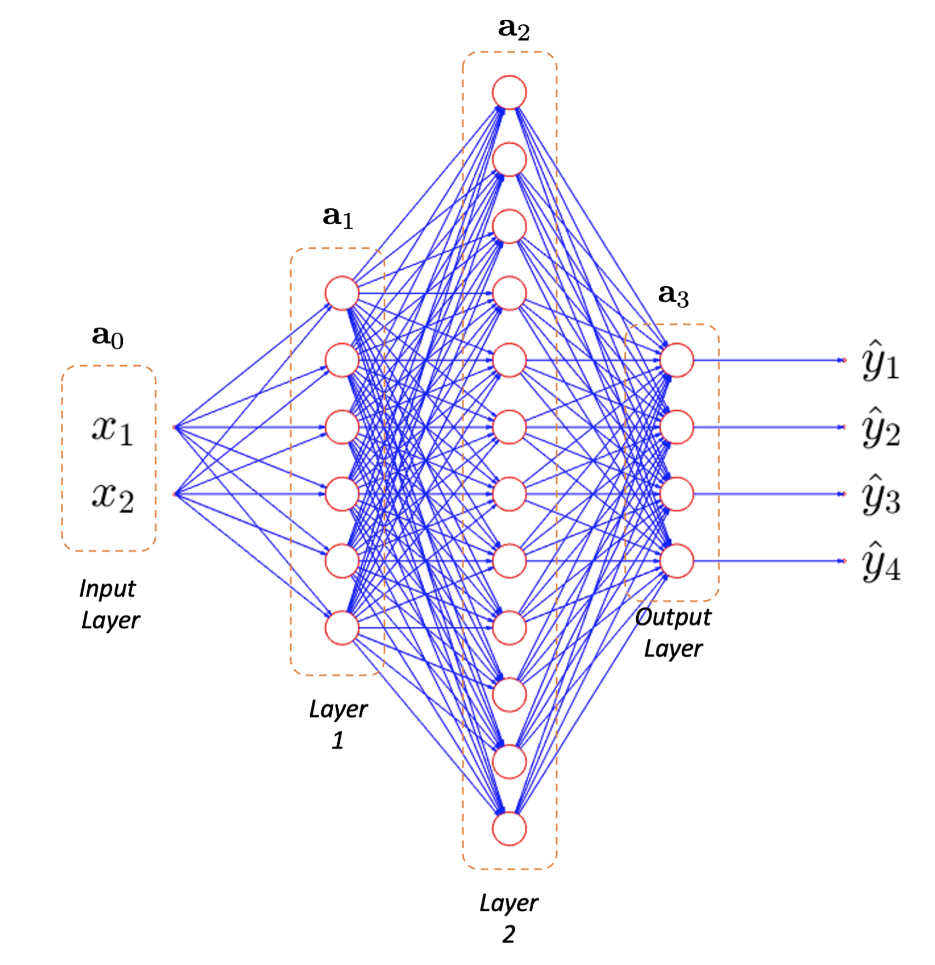
MOTIVATION
Neural networks

Slide 18
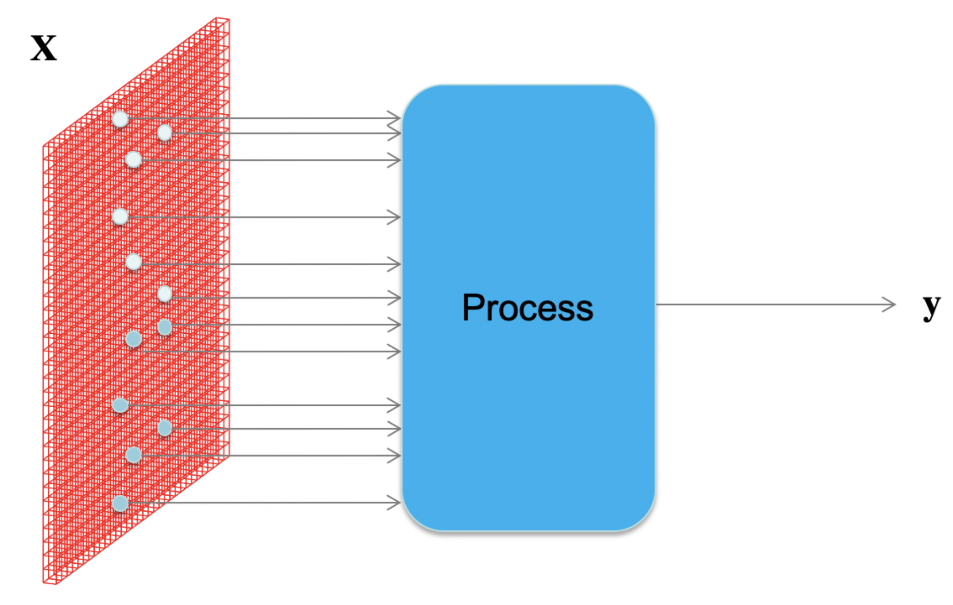
MOTIVATION
How to process an image with neural networks?

Slide 19
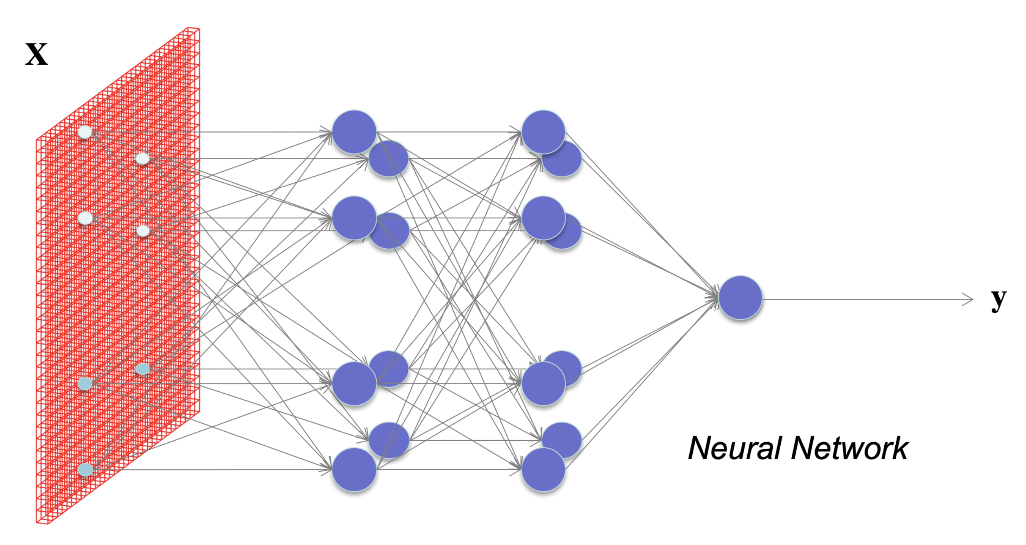

MOTIVATION
What happens if each pixel is an input?
How many neurons and weights?

Slide 20

© cibercontrols.org

Slide 21
Basics

Slide 22
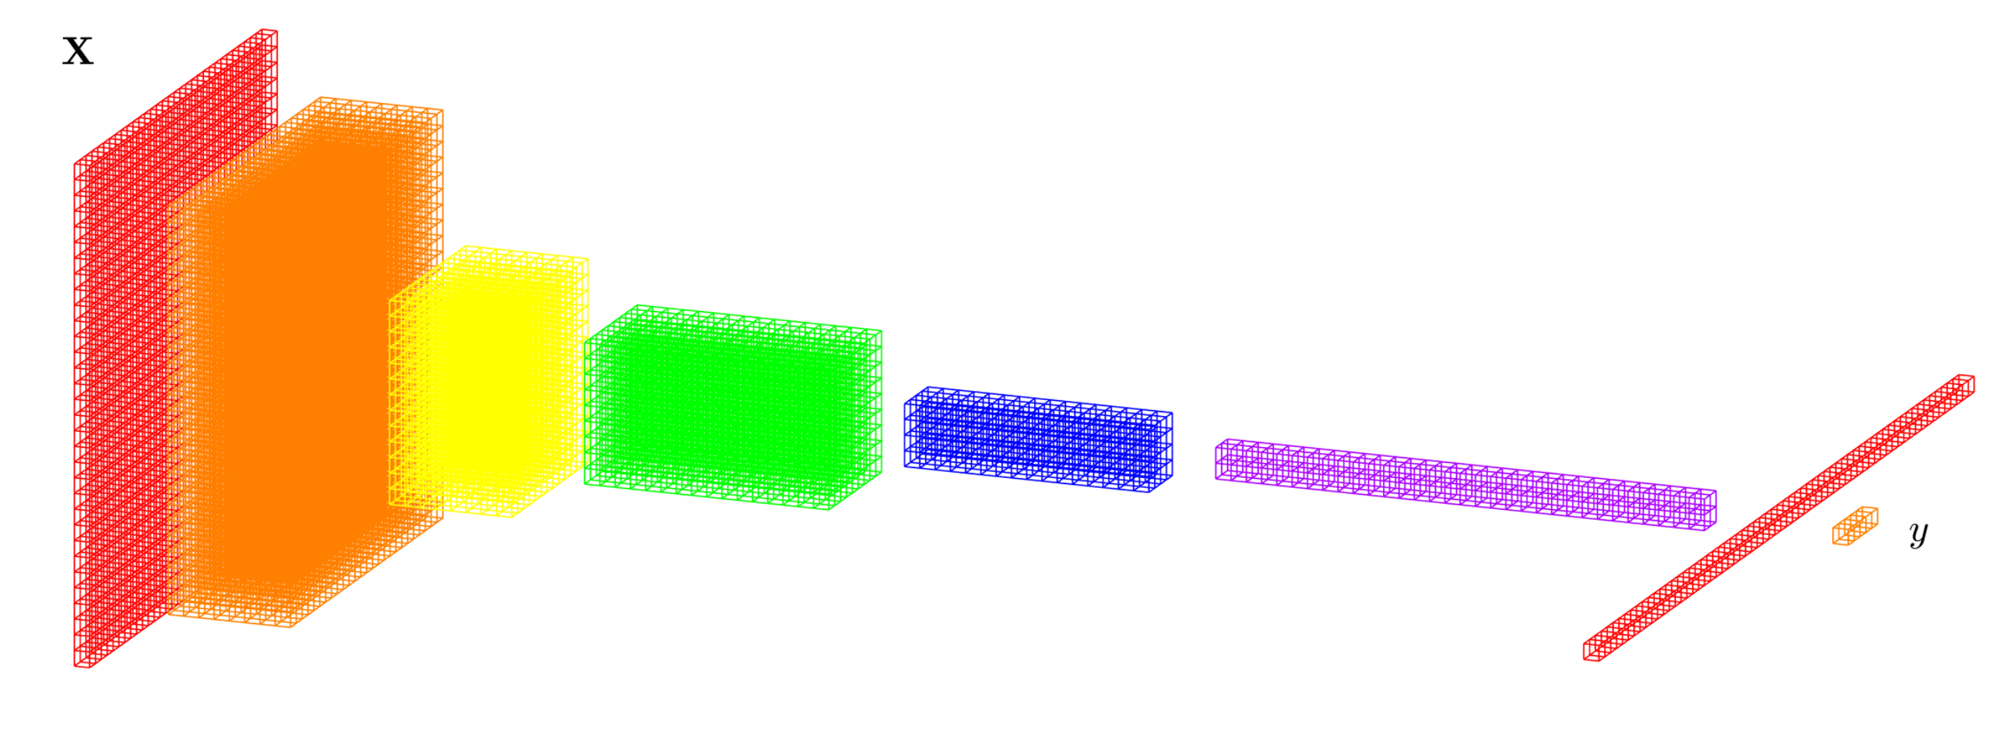
DEEP LEARNING BASICS (CNN)
Convolutional Neural Networks
Data
representation
Input
image
Layers
Classification

Slide 23
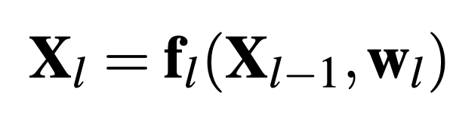
DEEP LEARNING BASICS (CNN)
Convolutional Neural Networks
f₁
f₂
f₃
f₄
f₅
f₇
f₆
Input
image
Layers
Classification

Slide 24
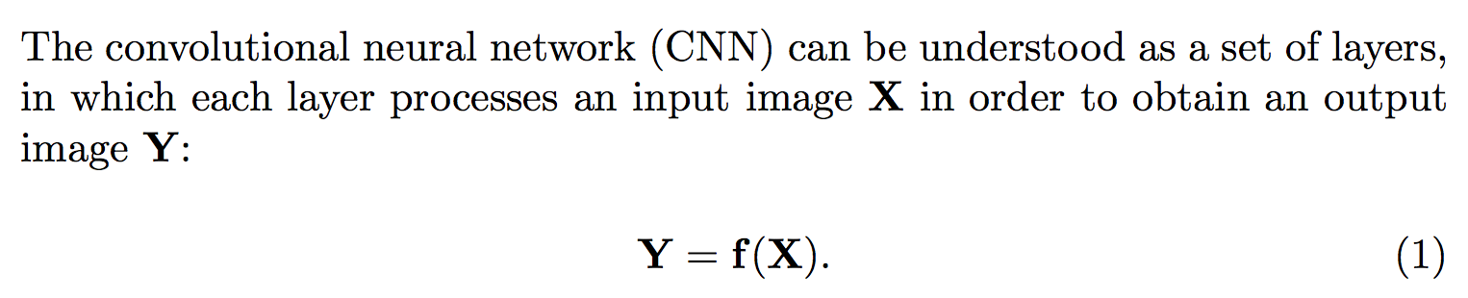
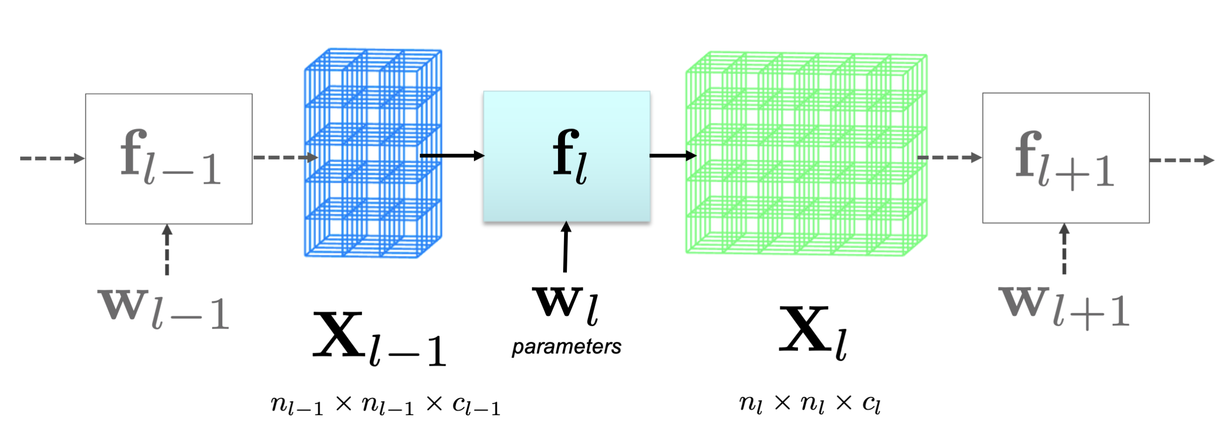
DEEP LEARNING BASICS

Slide 25
DEEP LEARNING: Typical layers
Convolution layer
Pooling layer
Rectified Linear Unit
Fully connected and SoftMax

Slide 26
DEEP LEARNING: Typical layers
Convolution layer
Pooling layer
Rectified Linear Unit
Fully connected and SoftMax

Slide 27
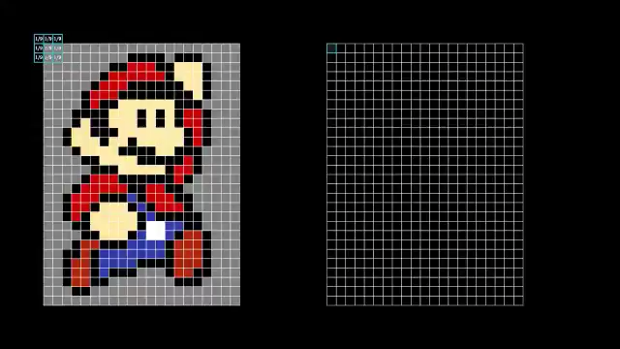
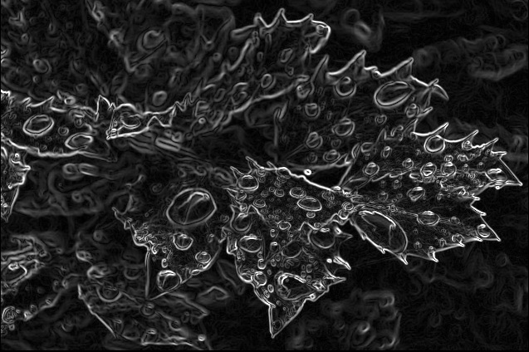
Image Processing: Filtering using Convolution
© @3blue1brown

Slide 28
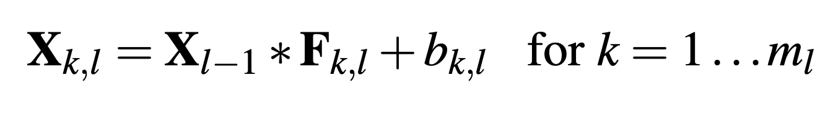
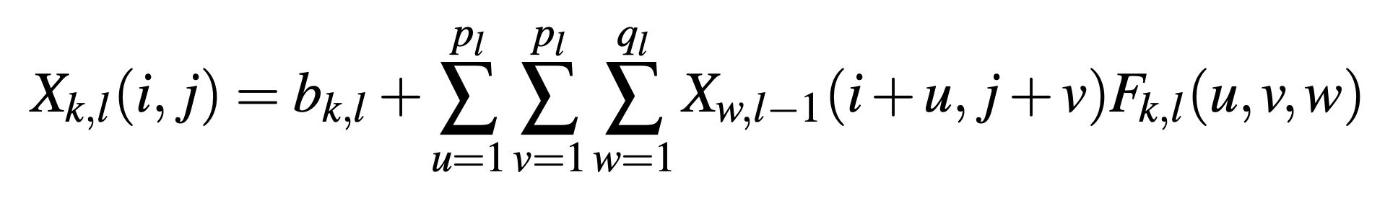
DEEP LEARNING: Convolution layer

Slide 29
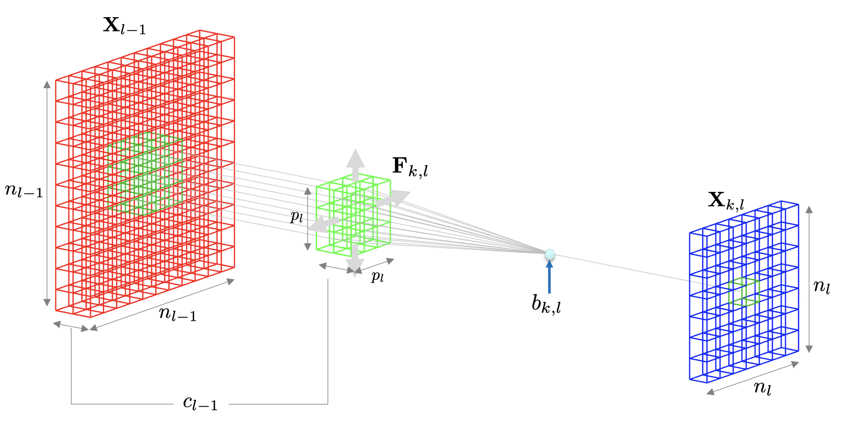
DEEP LEARNING: Convolution layer

Slide 30
DEEP LEARNING: Typical layers
Convolution layer
Pooling layer
Rectified Linear Unit
Fully connected and SoftMax

Slide 31
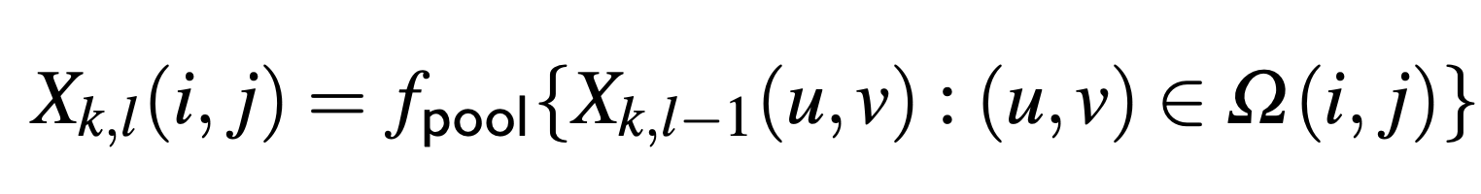
DEEP LEARNING: Pooling layer

Slide 32
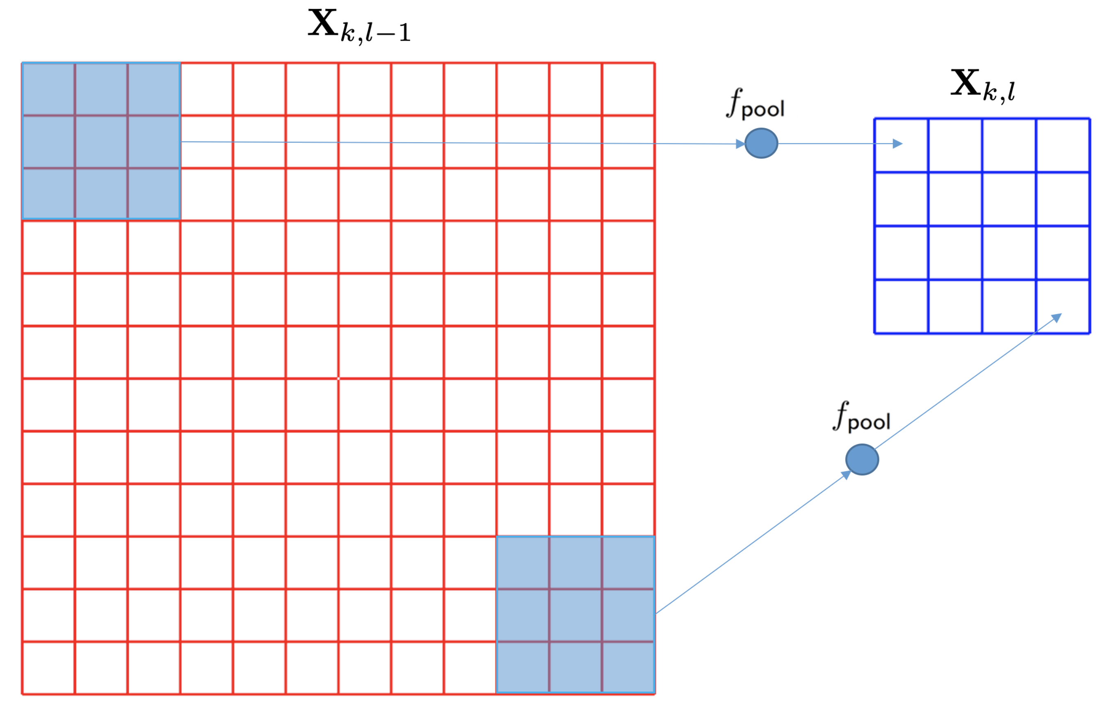
DEEP LEARNING: Pooling layer

Slide 33
DEEP LEARNING: Typical layers
Convolution layer
Pooling layer
Rectified Linear Unit
Fully connected and SoftMax

Slide 34
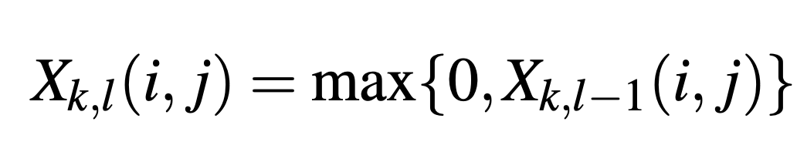
DEEP LEARNING: Rectified Linear Unit (ReLU)

Slide 35
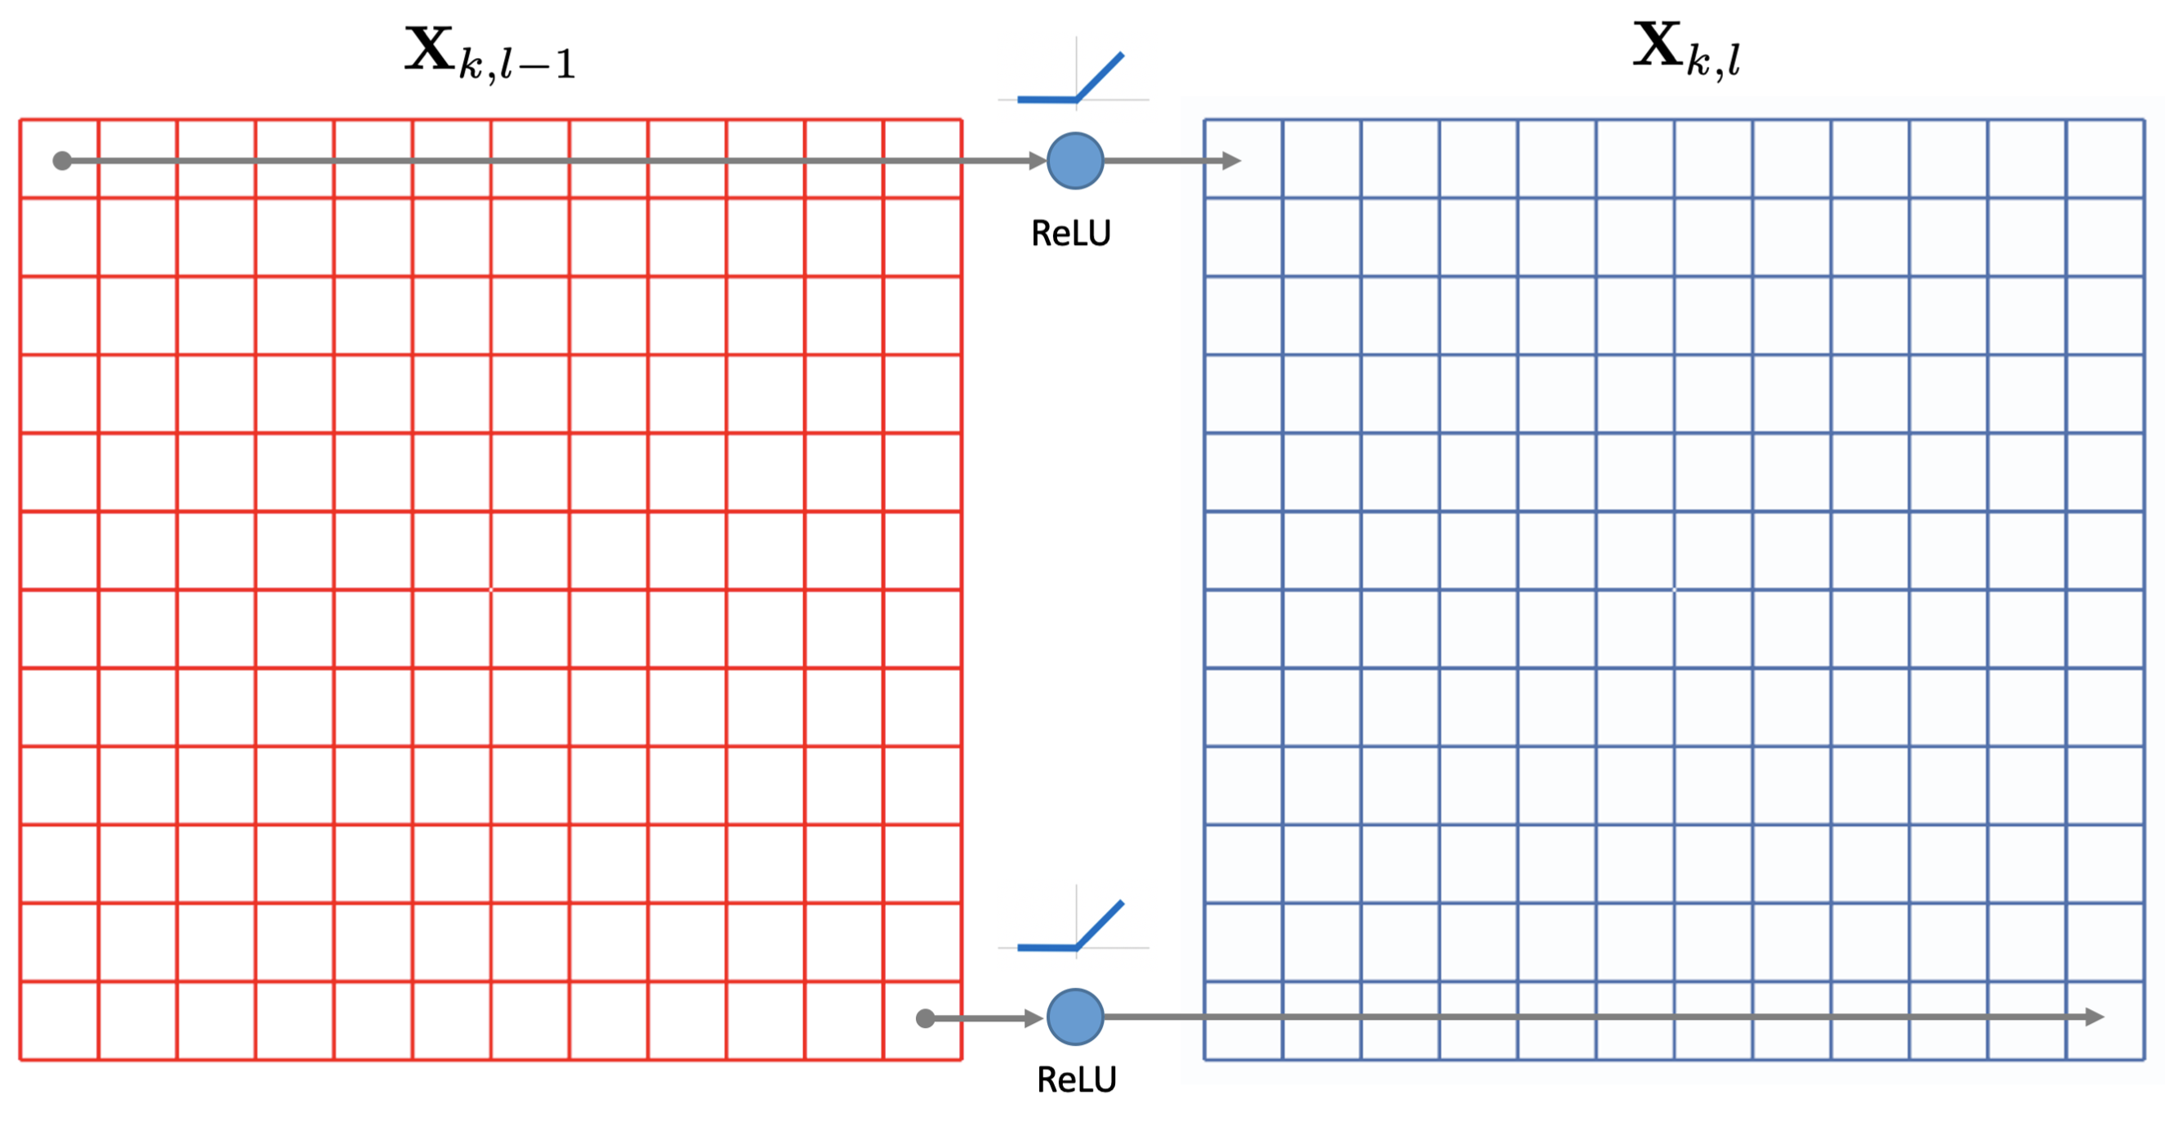
DEEP LEARNING: Rectified Linear Unit (ReLU)

Slide 36
DEEP LEARNING: Typical layers
Convolution layer
Pooling layer
Rectified Linear Unit
Fully connected and SoftMax

Slide 37
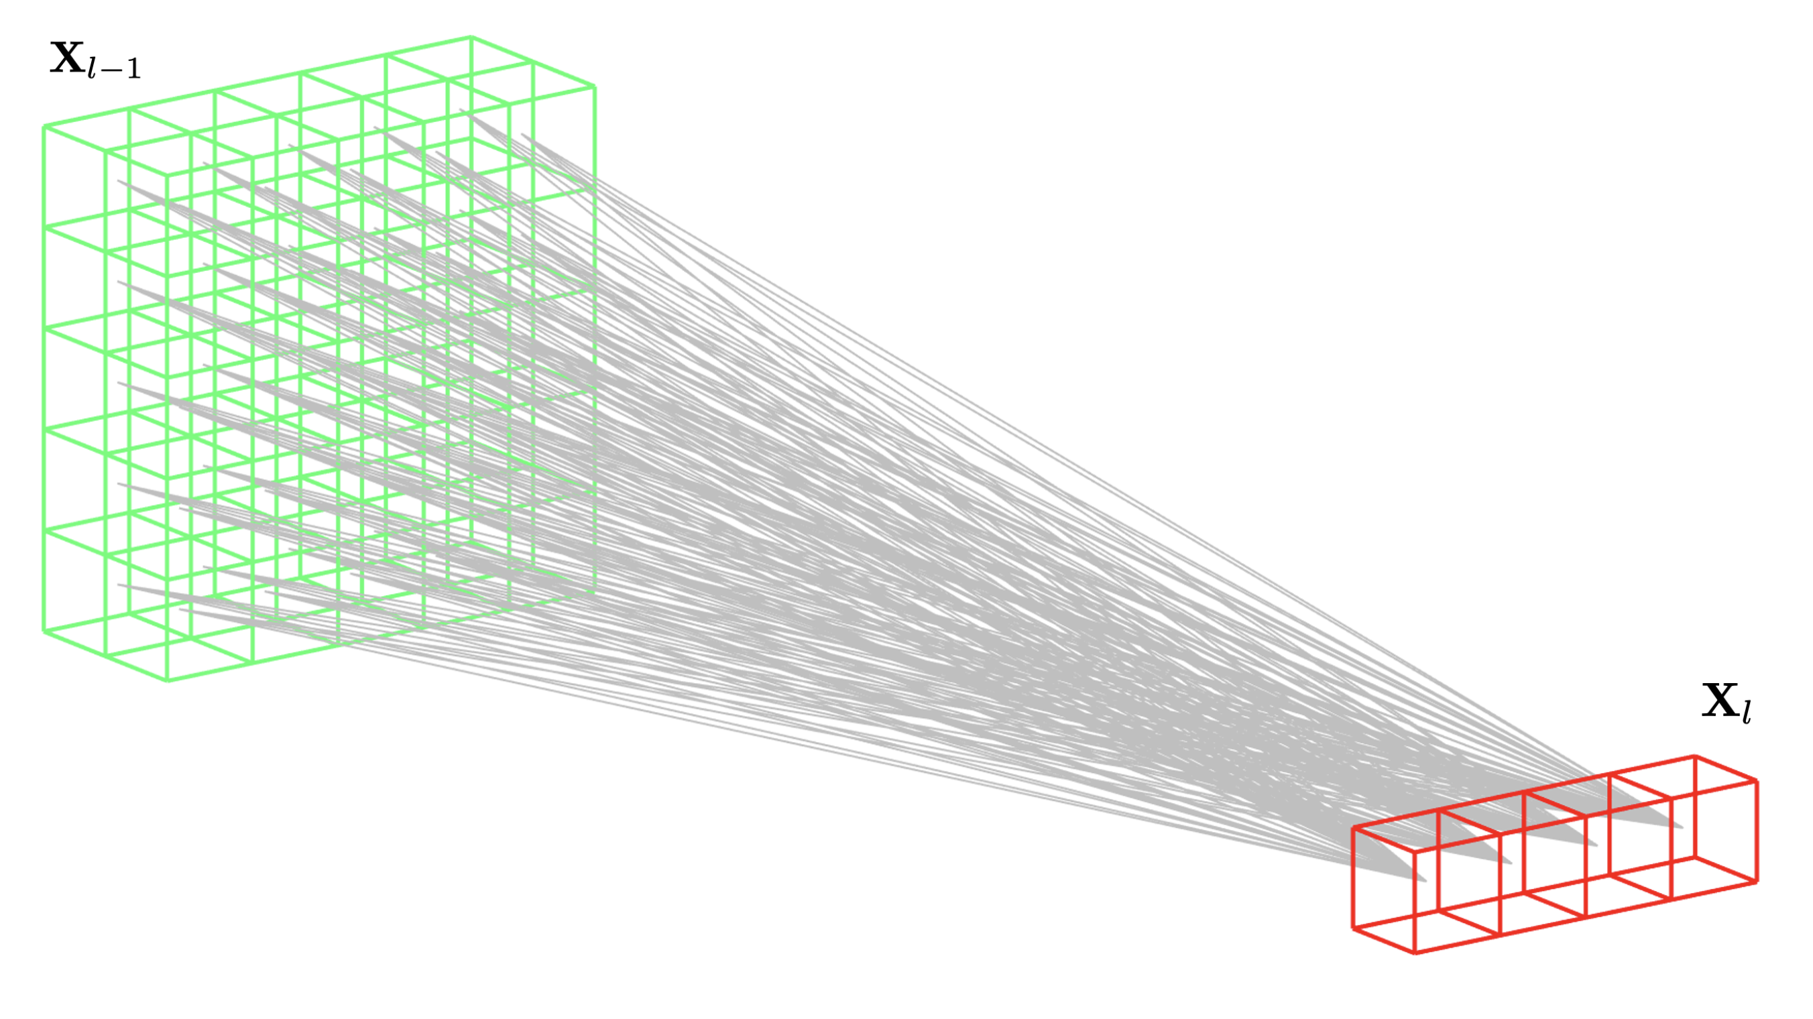
DEEP LEARNING: Fully Connected

Slide 38
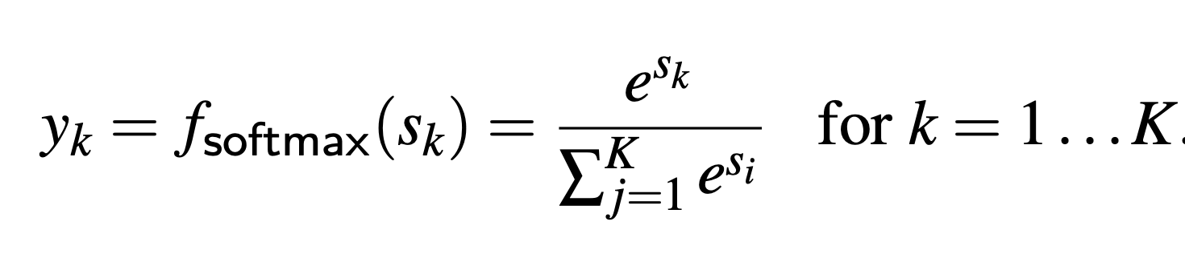
DEEP LEARNING: Fully Connected + SoftMax

Slide 39
© cibercontrols.org

Slide 40
Training

Slide 41
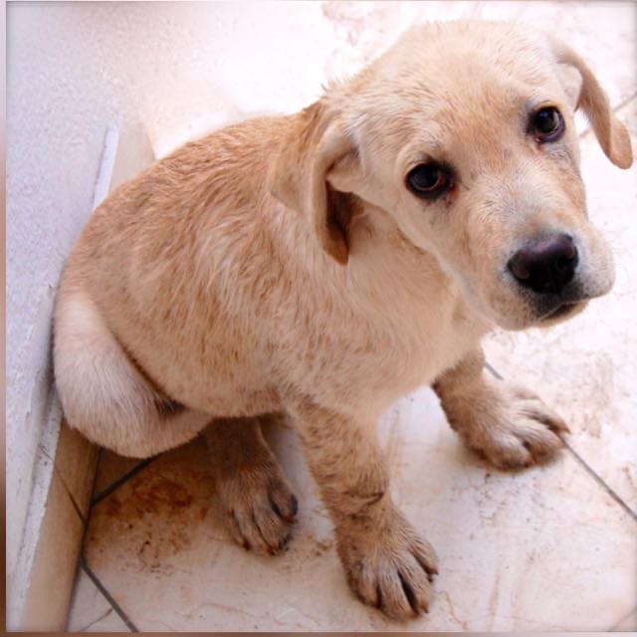
Image Classification – Problem
> Assign an image to a class or category
Image Classification
'dog’
Input: image
Output: Class

Slide 42
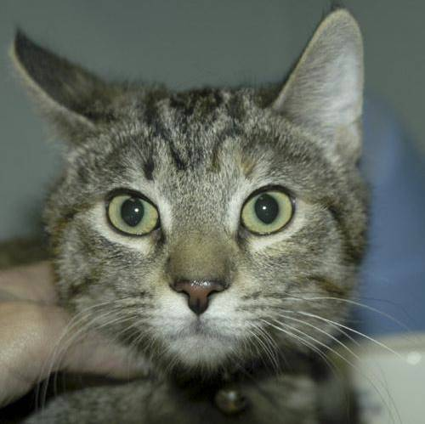
Image Classification – Problem
> Assign an image to a class or category
Image Classification
'cat’
Input: image
Output: Class

Slide 43
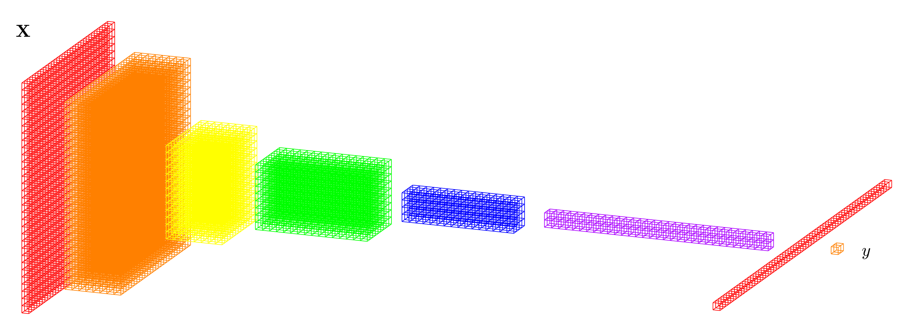

Image Classification – Solution
Deep Learning Model: CNN
Convolutional Neural Network
Layers
Output
Input image
Dog
Cat

Slide 44
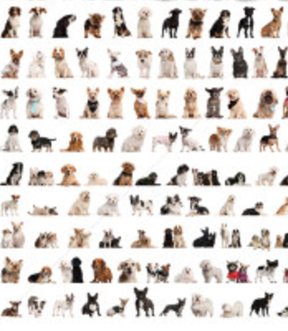
Image Classification – Solution
Deep Learning Model: CNN
Convolutional Neural Network
Dogs
errors
Cats
'dog’
Trained Model
Training Data
Back-propagation

Slide 45
DEEP LEARNING: Training
dogs
errors
cats
Back-propagation

Slide 46
Example
Eyes vs. Nose Recognizer

Slide 47
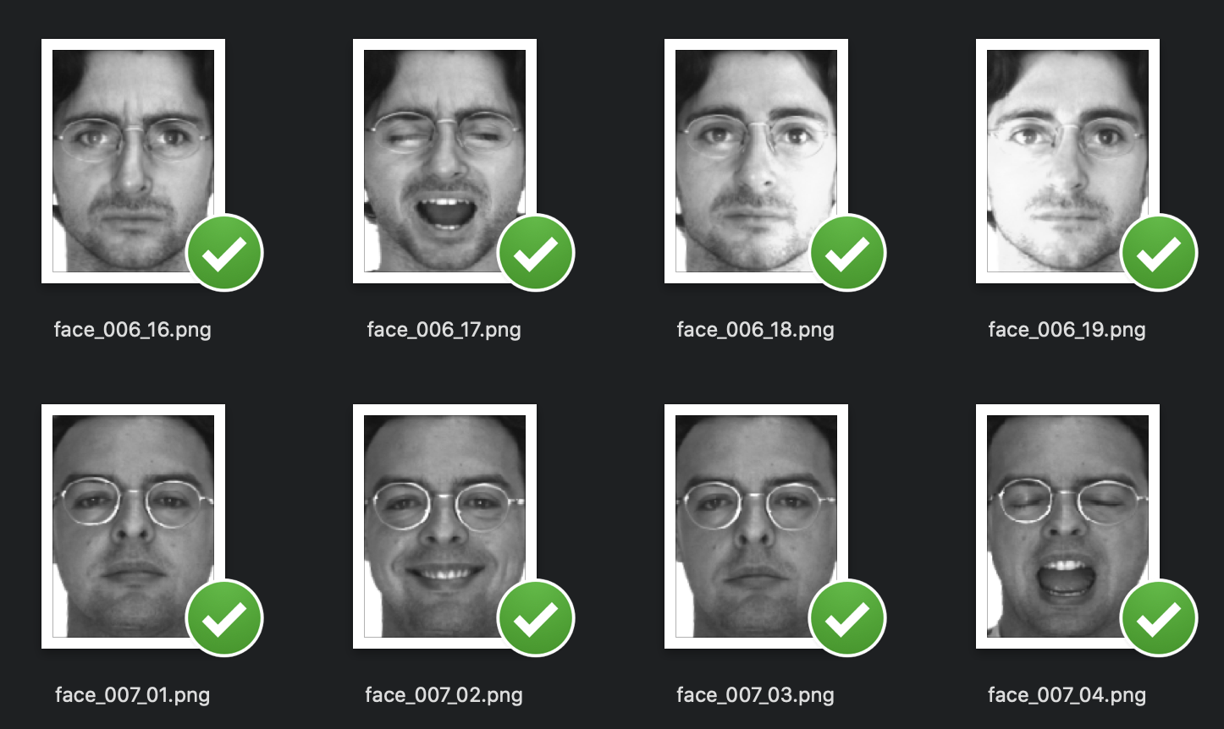
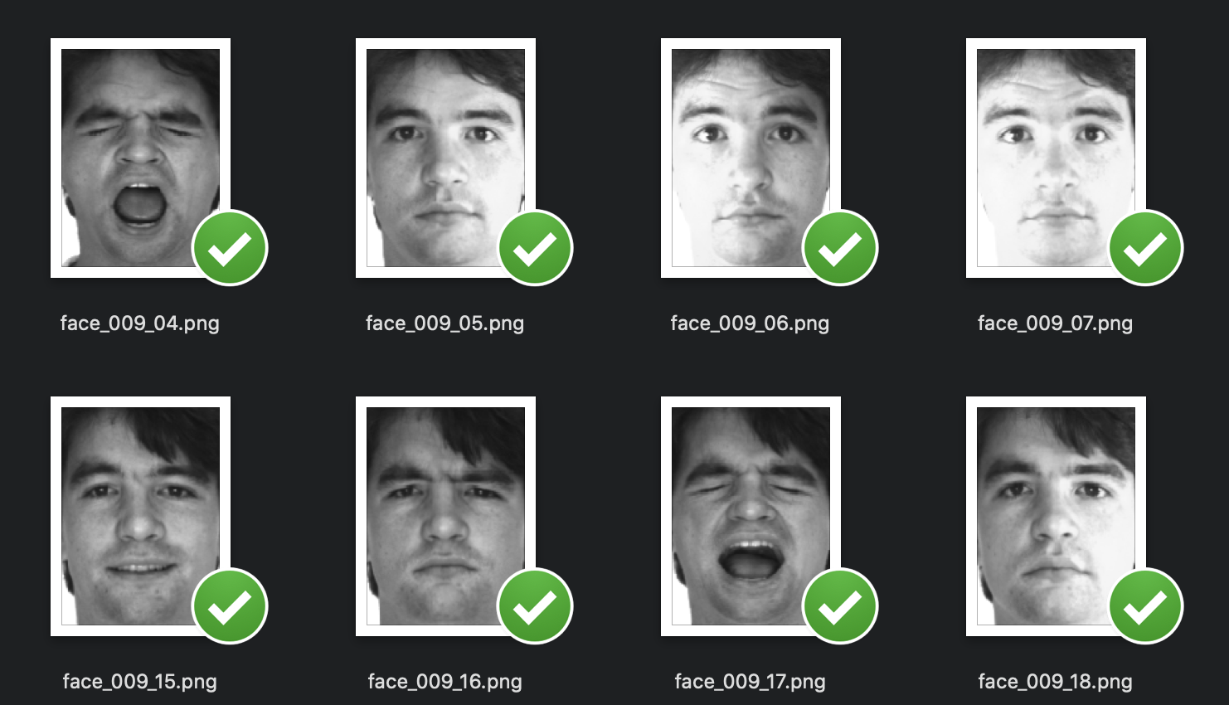

Slide 48
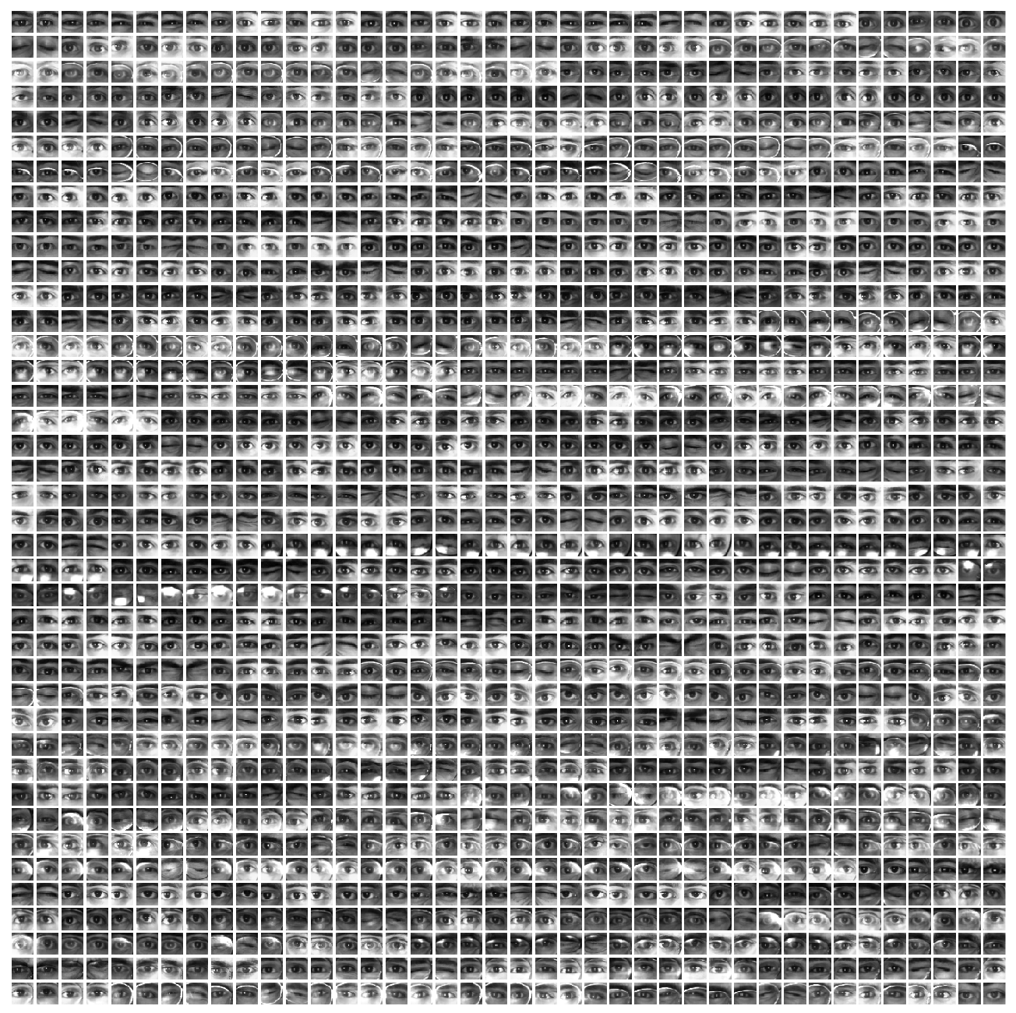
Eyes

Slide 49
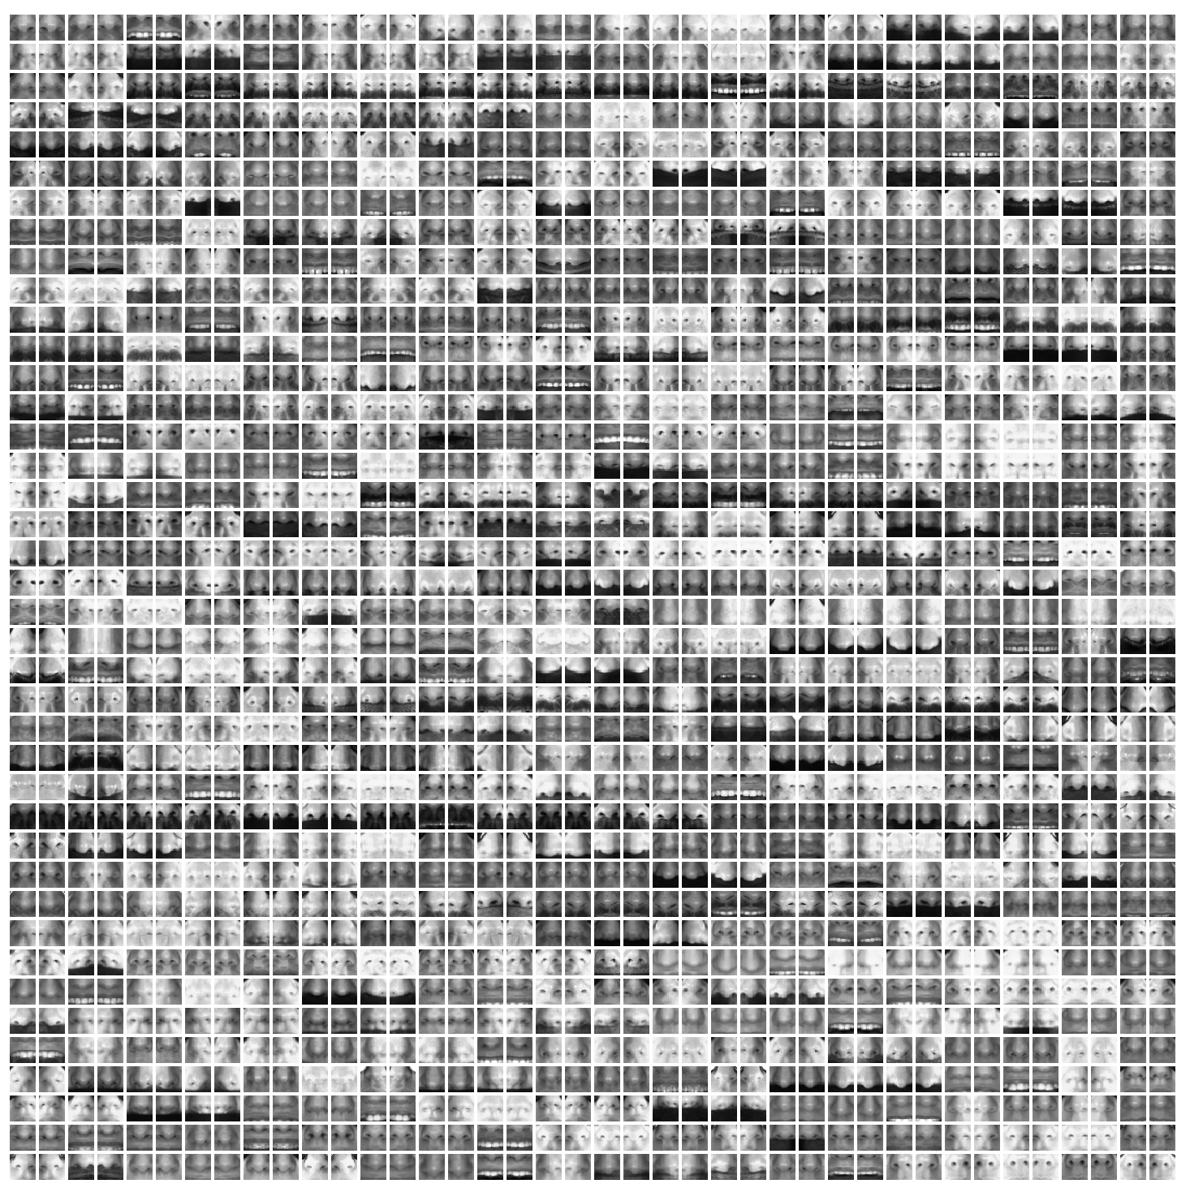
Noses

Slide 50
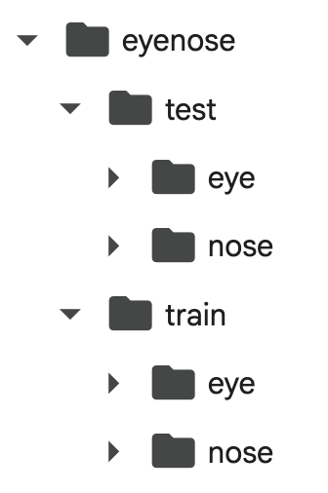
Eyes
&
Noses

Slide 51
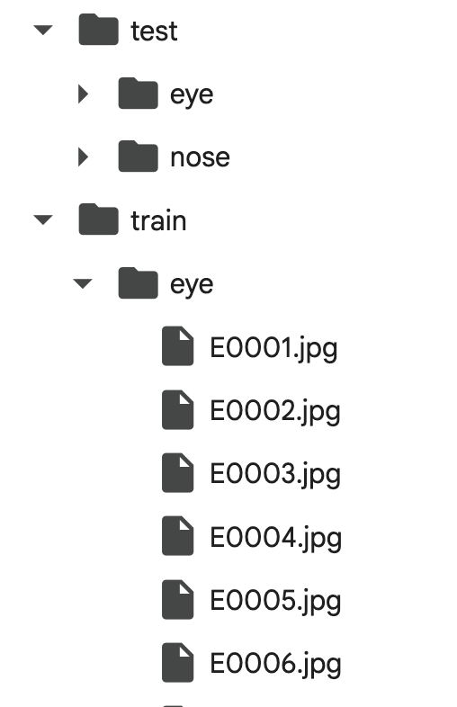
Eyes
&
Noses

Slide 52
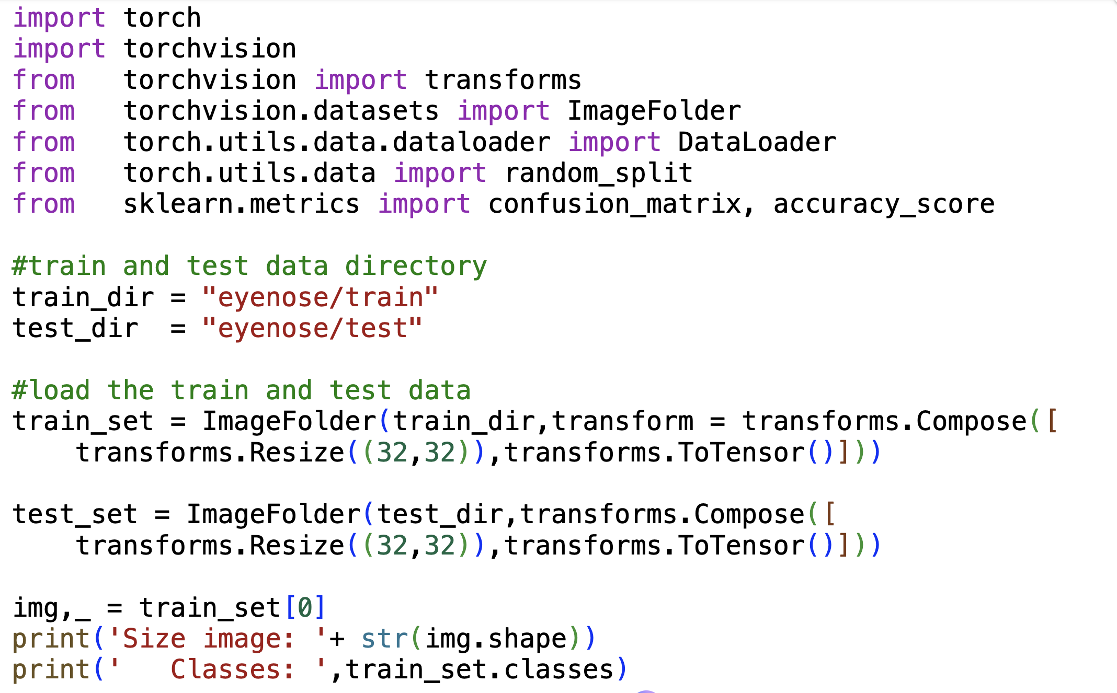
Eyes
&
Noses

Slide 53


Slide 54


Implementation in PyTorch

Slide 55




Slide 56


Slide 57

More Examples: MNIST

Slide 58

More Examples: Defects

Slide 59

More Examples: Cats vs Dogs

Slide 60

More Examples: Skin Cancer 2

Slide 61

More Examples: Skin Cancer 7

Slide 62

Pre-Trained Models

Slide 63


Slide 64


